Slide 1

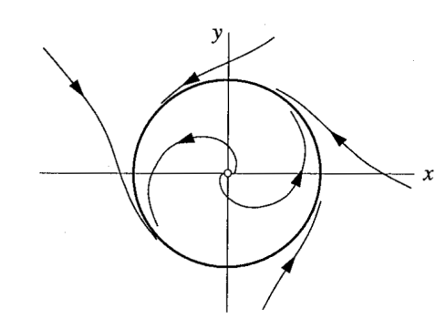
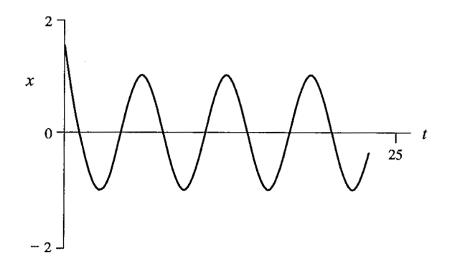
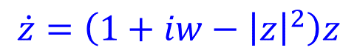
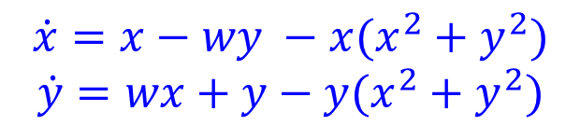
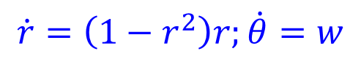
Limit Cycle
$$\dot{z}=\left(1+iw−{\left|z\right|}^{2}\right)z$$
$$\dot{r}=\left(1−r^{2}\right)r;\dot{θ}=w$$
Hence all trajectories in the phase plane (except $r^{∗} = 0$) approach the unit circle $r^{∗}=1$monotonically.
$$\dot{x}=x−wy −x(x^{2}+y^{2})$$
$$\dot{y}=wx+y−y(x^{2}+y^{2})$$

Slide 2
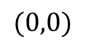
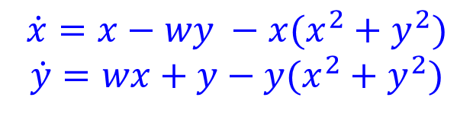
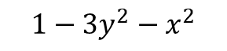
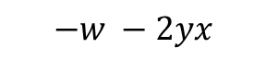
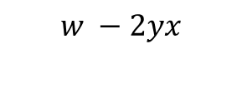
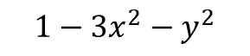
Limit Cycle
$$\dot{z}=\left(1+iw−{\left|z\right|}^{2}\right)z$$
$$\dot{r}=\left(1−r^{2}\right)r;\dot{θ}=w$$
Hence all trajectories in the phase plane (except $r^{∗} = 0$) approach the unit circle $r^{∗}=1$monotonically.
Jacobian
$$\dot{x}=x−wy −x(x^{2}+y^{2})$$
$$\dot{y}=wx+y−y(x^{2}+y^{2})$$
$$1−3x^{2}−y^{2}$$
$$−w −2yx$$
$$w −2yx$$
$$1−3y^{2}−x^{2}$$
$$(0,0)$$

Slide 3
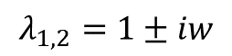
Limit Cycle
$$\dot{z}=\left(1+iw−{\left|z\right|}^{2}\right)z$$
$$\dot{r}=\left(1−r^{2}\right)r;\dot{θ}=w$$
Hence all trajectories in the phase plane (except $r^{∗} = 0$) approach the unit circle $r^{∗}=1$monotonically.
Jacobian
$$\dot{x}=x−wy −x(x^{2}+y^{2})$$
$$\dot{y}=wx+y−y(x^{2}+y^{2})$$
$$1−3x^{2}−y^{2}$$
$$−w −2yx$$
$$λ_{1,2}=1±iw$$
$$w −2yx$$
$$1−3y^{2}−x^{2}$$
$$(0,0)$$
Origin is an unstable spiral point for both the linear system and the nonlinear system.
Therefore, any solution that starts near the origin in the phase plane will spiral away from the origin.

Slide 4

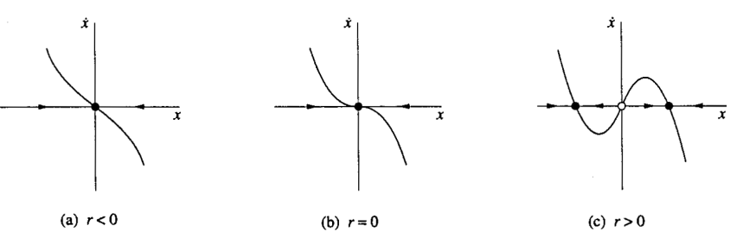
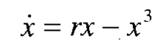
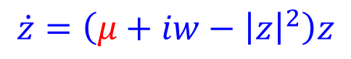
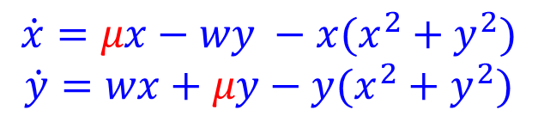
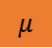
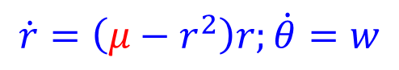
Limit Cycle
$$\dot{z}=\left(μ+iw−{\left|z\right|}^{2}\right)z$$
$$\dot{r}=\left(μ−r^{2}\right)r;\dot{θ}=w$$
$$\dot{x}=μx−wy −x(x^{2}+y^{2})$$
$$\dot{y}=wx+μy−y(x^{2}+y^{2})$$
$$μ$$
$$μ<0$$
$$μ=0$$
$$μ>0$$

Slide 5
Limit Cycle: VanderPol Oscillator
$${\ddot{x}}_{}+μ(x^{2}−1) \dot{x} +x = 0$$

Slide 6
Limit Cycle
A limit cycle refers to a repeating pattern of behavior in a dynamic system. While it is true that limit cycles are not necessarily circular, they may exhibit complex and irregular shapes. The statement that limit cycles are not generally circles and often need to be found numerically is accurate.
In many real-world systems, especially nonlinear systems, the behavior might not be described by simple sinusoidal functions. The trajectories of the system might follow more intricate paths, and determining the shape of the limit cycle may require numerical methods and simulations rather than analytical solutions.
If a trajectory is confined to a closed, bounded region that contains no fixed points, then the trajectory eventually must approach a closed orbit.

Slide 7
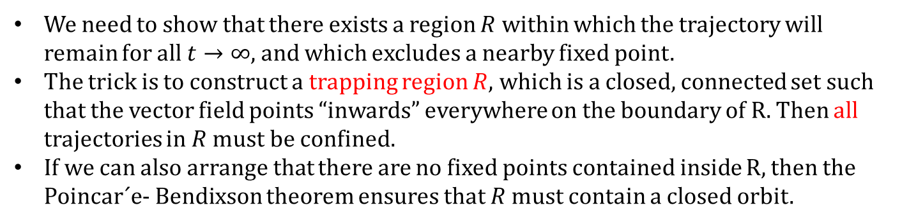
Limit Cycle
The Poincar´e-Bendixson Theorem
If a trajectory is confined to a closed, bounded region that contains no fixed points, then the trajectory eventually must approach a closed orbit.
To determine if a trajectory is confined to a closed, bounded region
We need to show that there exists a region $R$ within which the trajectory will remain for all $t→∞$, and which excludes a nearby fixed point.
The trick is to construct a trapping region $R$, which is a closed, connected set such that the vector field points “inwards” everywhere on the boundary of R. Then all trajectories in $R$ must be confined.
If we can also arrange that there are no fixed points contained inside R, then the Poincar´e- Bendixson theorem ensures that $R$ must contain a closed orbit.

Slide 8
Limit Cycle
The Poincar´e-Bendixson Theorem
If a trajectory is confined to a closed, bounded region that contains no fixed points, then the trajectory eventually must approach a closed orbit.
To determine if a trajectory is confined to a closed, bounded region
We need to show that there exists a region $R$ within which the trajectory will remain for all $t→∞$, and which excludes a nearby fixed point.
The trick is to construct a trapping region $R$, which is a closed, connected set such that the vector field points “inwards” everywhere on the boundary of R. Then all trajectories in $R$ must be confined.
If we can also arrange that there are no fixed points contained inside R, then the Poincar´e- Bendixson theorem ensures that $R$ must contain a closed orbit.

Slide 9
Networks and Dynamics
Synchrony in limit cycles : Active and Inactive systems
Stability of large predator-prey systems
Kuramoto oscillators

Slide 10
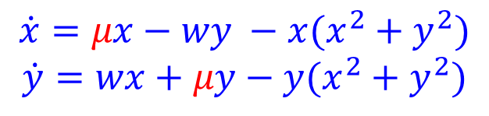
Network of Limit Cycle: active and inactive oscillators
$$\dot{z}=\left(μ+iw−{\left|z\right|}^{2}\right)z$$
$$\dot{x}=μx−wy −x(x^{2}+y^{2})$$
$$\dot{y}=wx+μy−y(x^{2}+y^{2})$$
$$\dot{r}=\left(μ−r^{2}\right)r;\dot{θ}=w$$

Slide 11
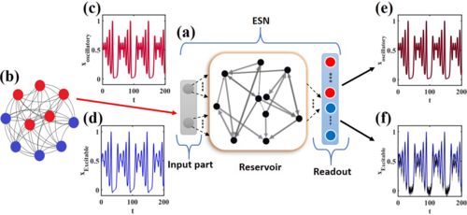
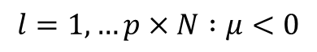
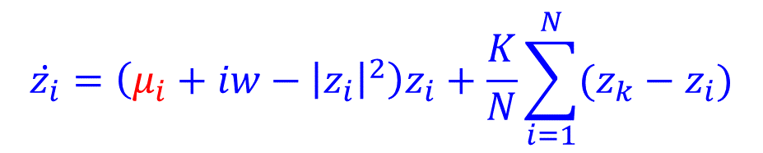
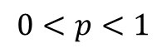
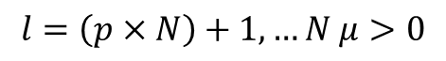
Network of Limit Cycle: active and inactive oscillators
$$\dot{z}=\left(μ+iw−{\left|z\right|}^{2}\right)z$$
$$\dot{x}=μx−wy −x(x^{2}+y^{2})$$
$$\dot{y}=wx+μy−y(x^{2}+y^{2})$$
$$\dot{r}=\left(μ−r^{2}\right)r;\dot{θ}=w$$
$$\dot{z_{i}}=\left(μ_{i}+iw−{\left|z_{i}\right|}^{2}\right)z_{i}+\frac{K}{N}\sum_{i=1}^{N}{(z_{k}−z_{i})}$$
$$0<p<1$$
$$l=1,…p×N :μ<0$$
$$l=\left(p×N\right)+1,…N μ>0$$

Slide 12
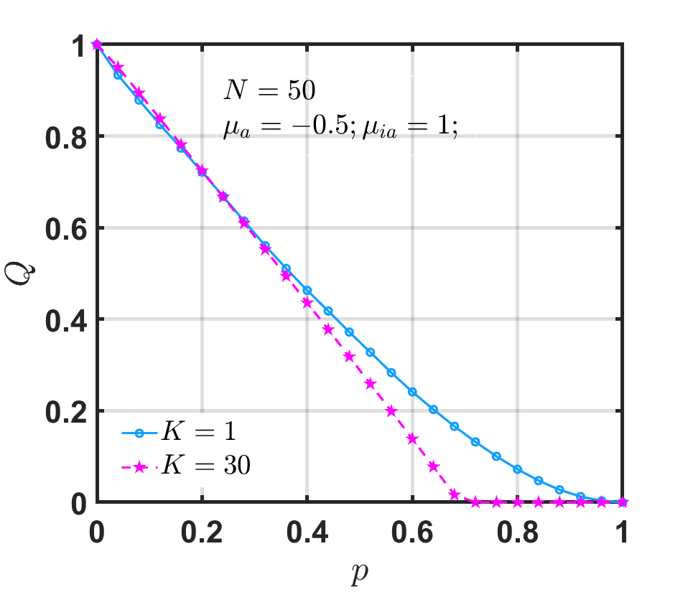
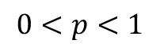
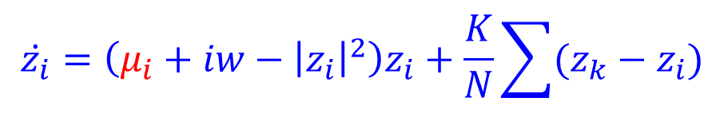


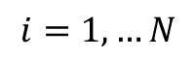
Network of Limit Cycle: active and inactive oscillators
$$\dot{z_{i}}=\left(μ_{i}+iw−{\left|z_{i}\right|}^{2}\right)z_{i}+\frac{K}{N}\sum{(z_{k}−z_{i})}$$
$$i=1,…N$$
$$0<p<1$$
$$l=1,…p×N :μ<0$$
$$l=\left(p×N\right)+1,…N μ>0$$

Slide 13
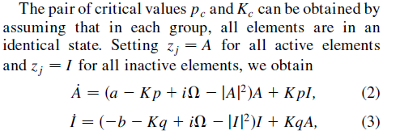
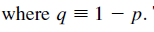
Network of Limit Cycle: active and inactive oscillators
(reduction )
$$\dot{z_{i}}=\left(μ_{i}+iw−{\left|z_{i}\right|}^{2}\right)z_{i}+\frac{K}{N}\sum{(z_{k}−z_{i})}$$
$$i=1,…N$$
$$0<p<1$$
$$l=1,…p×N :μ<0$$
$$l=\left(p×N\right)+1,…N μ>0$$

Slide 14
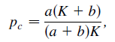
Network of Limit Cycle: active and inactive oscillators
(reduction )
$$\dot{z_{i}}=\left(μ_{i}+iw−{\left|z_{i}\right|}^{2}\right)z_{i}+\frac{K}{N}\sum{(z_{k}−z_{i})}$$
$$i=1,…N$$
$$0<p<1$$
$$l=1,…p×N :μ<0$$
$$l=\left(p×N\right)+1,…N μ>0$$

Slide 15
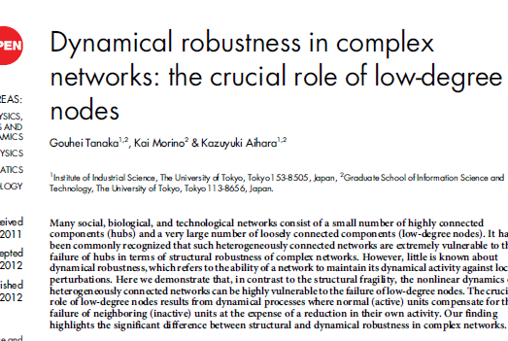
Network of Limit Cycle: active and inactive oscillators

Slide 16

Network of Limit Cycle: active and inactive oscillators

Slide 17
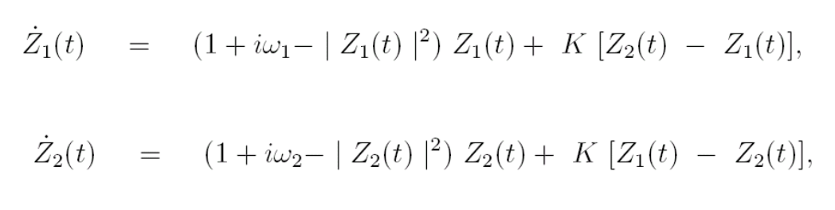
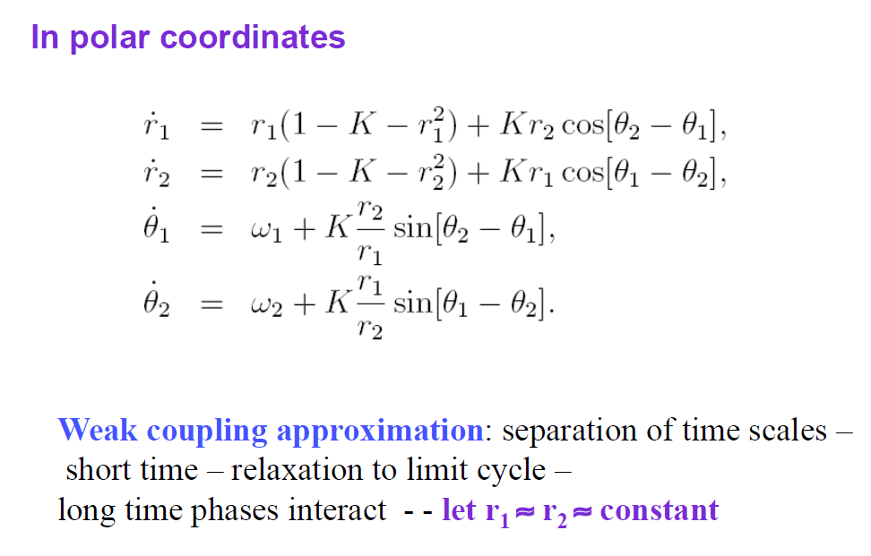
Synchrony in Limit cycle Oscillators

Slide 18
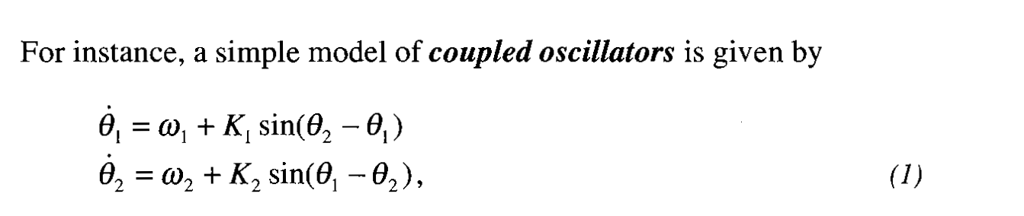

Slide 19
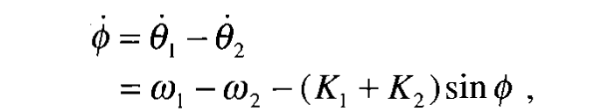
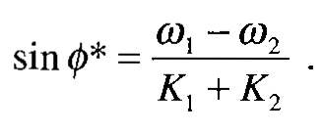

Slide 20
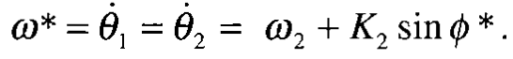
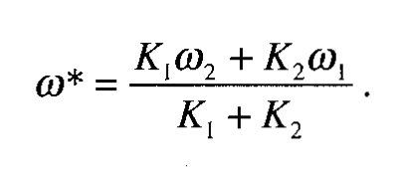

Slide 21
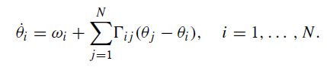
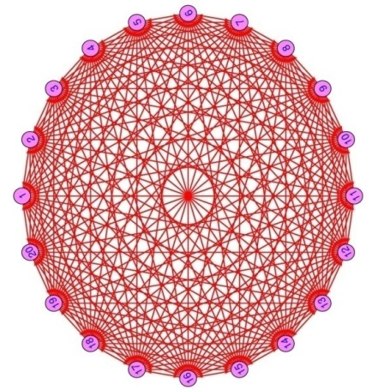
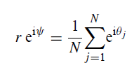
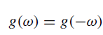
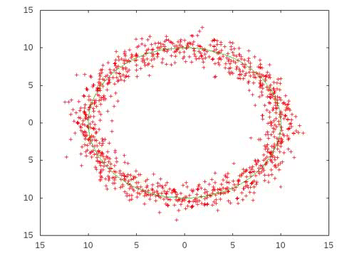
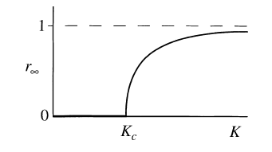
Synchrony in Kuramoto Dynamics : Global Interaction
g(ω)
g(0)
ω
Phase transition
k_{c} = 2 / π g(0) N
Kuramoto Y (1984). Chemical Oscillations, Waves, and Turbulence. New York, NY: Springer-Verlag.

Slide 22
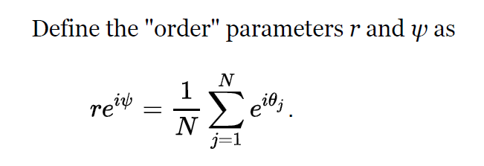
Synchrony in Kuramoto Dynamics : Global Interaction
g(ω)
g(0)
Phase transition
ω
The Kuramoto model: A simple paradigm for synchronization phenomena
Juan A. Acebrón, L. L. Bonilla, Conrad J. Pérez Vicente, Félix Ritort, and Renato Spigler
Rev. Mod. Phys. 77, 137 – Published 7 April 2005
k_{c} = 2 / π g(0) N
Kuramoto Y (1984). Chemical Oscillations, Waves, and Turbulence. New York, NY: Springer-Verlag.

